Slide 1
Autonomous Mobile Robot Localization using Kalman Filters.
TEAM
Meenakshi S
Vinay Arun Kumar
Jibin Jacob
Karthik MS

Slide 2
Contents
Objectives
Literature Survey
Methodology
Applications
Further Advancements
Scope in Military
Timeline
References

Slide 3
Objectives
The purpose of this project is to design and implement AMR localization using Kalman filters from multiple sources of pose information.
To improve the pose accuracy of a robot.
Analysing the external environment and making changes accordingly in pose values using Kalman filter.

Slide 4

Literature survey
The robot localization problem is a key problem in making truly autonomous robots.
If a robot does not know where it is, it can be difficult to determine what to do next
In order to localize itself, a robot has access to multiple pose information giving the robot feedback about situation of the environment around the robot.

Slide 5
Literature Survey
Achieving the target precisely in any environment is not an easy task since there are noises and obstacles in the surrounding environment.
filtering the signals to reduce noises is essential for more accurate and precise motion.
In this project, we selected the extended Kalman filter, which is used for non-linear models' signals to predict the pose of a wheeled robot.

Slide 6

Methodology
Localization of robot are commonly affected by the inaccuracy of the sensors.
These inaccuracies are caused by various factors which includes internal interferences of the sensor and external environment noises.
In order to overcome these noises, a filtering method is required in order to improve the robot’s localization.

Slide 7
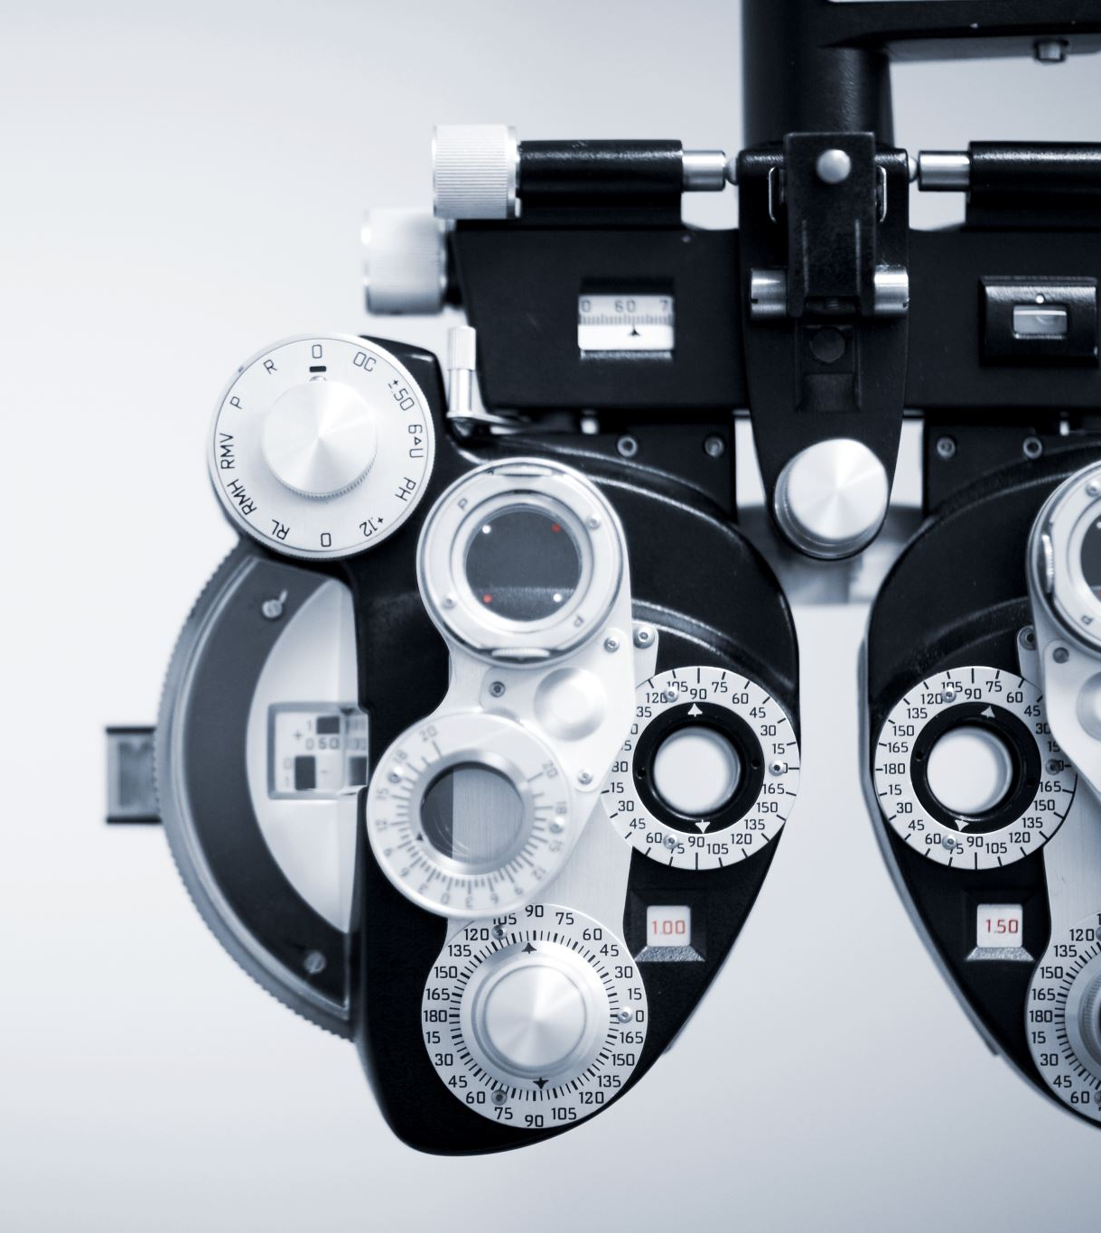
Methodology
In our project, we use a differential drive indoor surveillance robot will be used as a platform.
The wheel odometers, inertial measurement unit (IMU), and 2D LIDAR are used for data collection.
Data collected is processed using Kalman filter to predict and correct the pose error from these sensors reading.
We are planning to use either MATLAB robotic toolbox or ROS environment along with gazebo simulation for doing this project.

Slide 8

Indoor GPS
Determines location of objects inside a building using following technologies
Wi-Fi positioning
Inertial Measurement Units(IMU)
Visual recognition

Slide 9
Advantages of Indoor GPS
Enables better navigation
Improve operational efficiency and productivity
Provide valuable data for retail and marketing applications

Slide 10
Disadvantages of indoor GPS
Accuracy affected by many factors
Require additional sensor to be installed in indoor environment
Less reliable than outdoor GPS

Slide 11
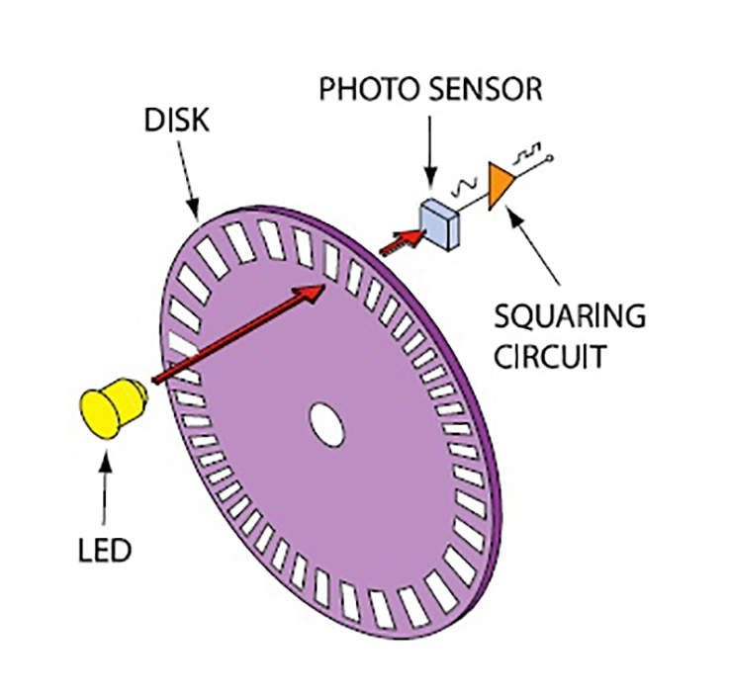
Optical Wheel Encoder
A device that measures position and speed of wheel or shaft
consists of an encoder wheel with slots or markings, and a sensor that detects the slots or markings and generates electrical signals.
As the wheel or shaft rotates, the encoder wheel passes by the sensor, which detects the slots or markings and generates a corresponding electrical signal. The number of slots or markings on the encoder wheel determines the resolution of the encoder.

Slide 12

Advantages and Disadvantages of Optical Wheel Encoder
Easy to install and maintain
Offers high accuracy
Low cost
Susceptible to contamination
Have limited maximum speed
Have limited resolution in some case

Slide 13

Holonomic Robots
Have ability to move in all directions
Have no constraints
Have three or more degrees of freedom

Slide 14

Non Holonomic Robot
Cannot move freely in all directions
Have constraints
Constraints arise from physical design of robot or from external environment
Have fewer degrees of freedom
Are more challenging to control and navigate due to constraints

Slide 15
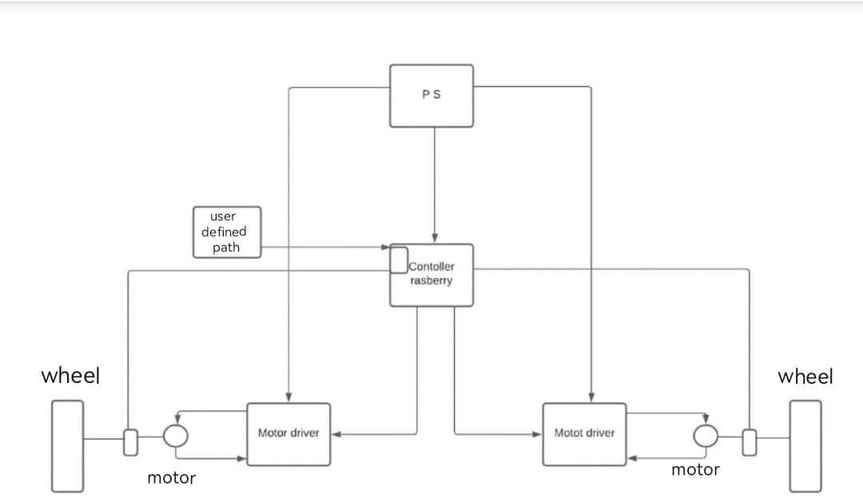
Block Diagram

Slide 16
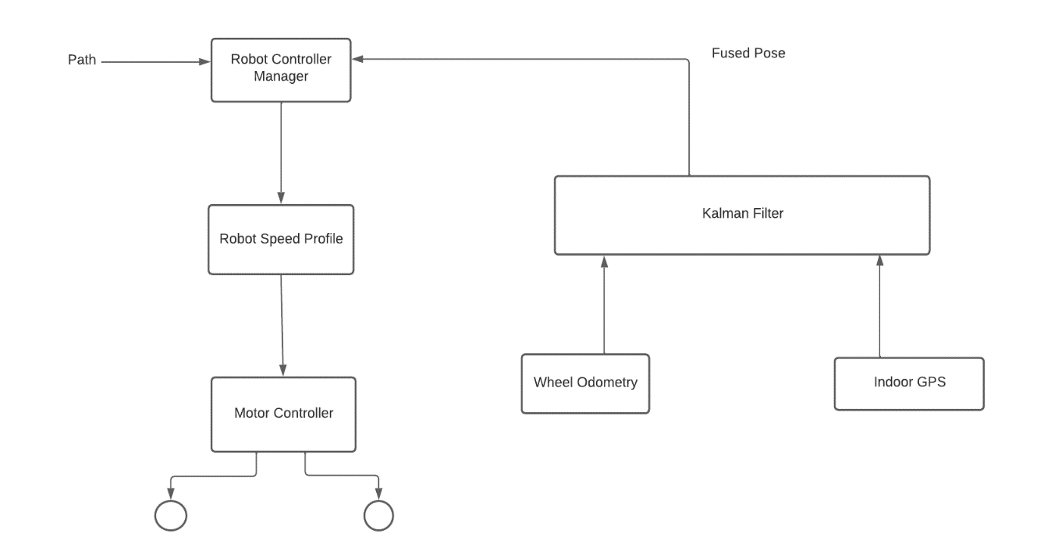
Block Diagram

Slide 17
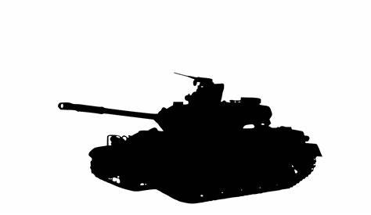
APPLICATIONS
Blind people
Receptionist
Defense

Slide 18

Integrating with military private blockchains
Most secure and most precise position detection for drones

Slide 19

Time-line
14 Mar. 2023
By 14 March 2023 – A flow diagram on how to proceed with the project, implementing it practically.
Mar. 2023
By end of March 2023 – creating an experimental environment, setting up all the sensors and obtaining test data on position of a test sample.
April
Half of April
By half of April – determining error generated through position detection using sensors alone and setting up circuitry for Kalman filter.
End of April
By the end of April – implementing Kalman filter on the input data of sensors and determine positions.
May
Half of May
By the half of may, we intend to wind off our project by comparing both positions with and without Kalman filters, we can analyze the errors and conclude on error minimalization.
End of May
Final product exhibition and testing data flows to cloud and blockchains.

Slide 20

Reference
Thesis by Rudy Negenberg in 2003 based on Robot Localization and Kalman Filters
Alhamandi Eman, IEEE,2018 - on mobile robot localization using extended kalman filter.

Slide 21

Thankyou!

